Slide 1
Python Basics

Slide 2
Introduction
In this presentation, we will provide an overview of Python and how it compares to other programming languages. This will give you a sense of where Python fits in the programming landscape.

Slide 3
Python in the Modern World
One of the top languages in TIOBE and RedMonk rankings (currently nr 1 on Tiobe).
Central to many startups and tech giants alike.
Continues to evolve with new features and enhancements (e.g., pattern matching in Python 3.10)
Python is the fastest growing language according to PYPL

Slide 4
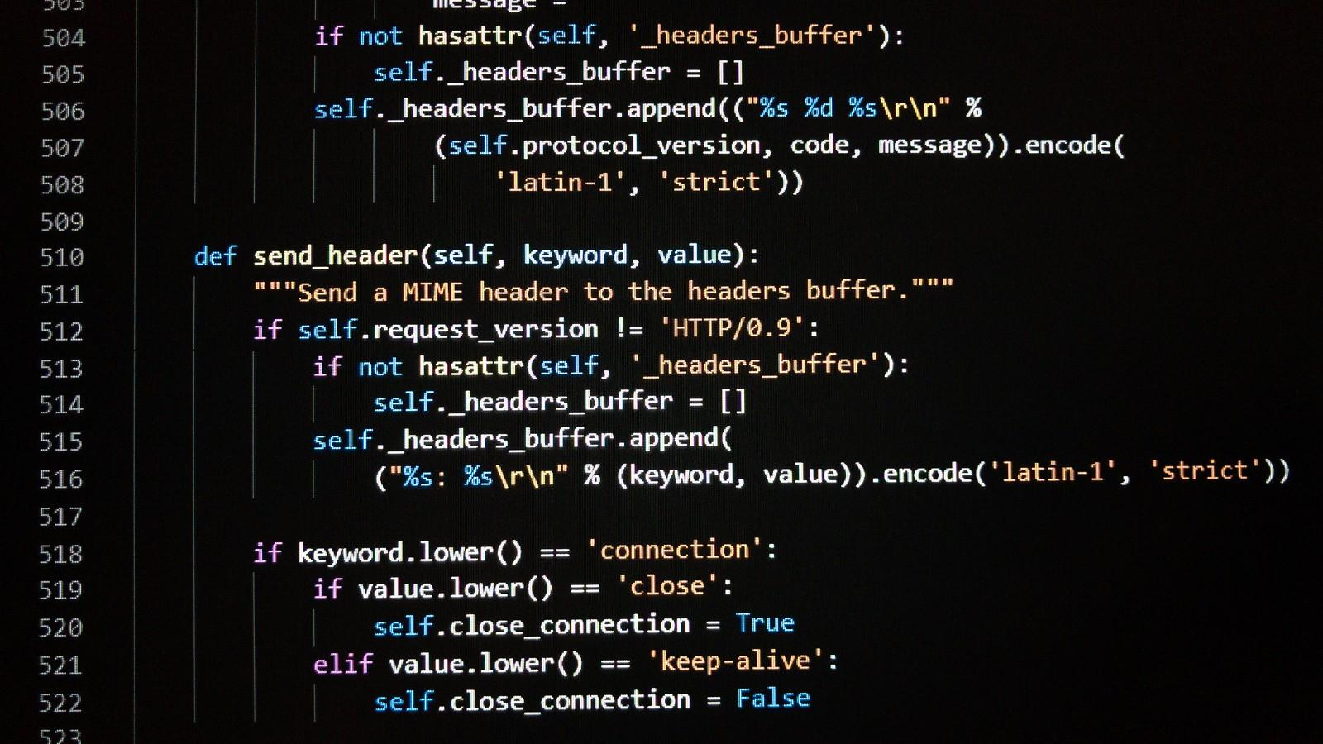
Python's Syntax Characteristics
Indentation-based: relies on whitespace to define code blocks.
Dynamically typed: no need to declare variable types.
Readable and clean syntax: often referred to as "executable pseudocode."

Slide 5
Strengths of Python
Versatile: used in many domains from web development (Django, Flask) to machine learning (TensorFlow, scikit-learn).
Portable: you can run the same code on any operating system with a Python interpreter.
Large standard library and vibrant ecosystem.
Active and supportive community.

Slide 6
Weaknesses and Criticisms
Can be slower than languages like C or Java due to being an interpreted language.
Global Interpreter Lock (GIL) prevents multi-threaded Python programs from taking full advantage of multiple CPU cores.
Python's simplicity can also be a weakness for large, complex projects that may benefit from strict typing and explicit tooling.
Packaging and environment management can be challenging for newcomers.
Python 2 vs Python 3 fragmentation led to some libraries only supporting one version for a long time.

Slide 7
Use Cases for Python
Excellent for prototyping and rapid development.
Web development with frameworks like Django and Flask.
Data analysis and visualization with libraries like Pandas and Matplotlib.
Machine learning and AI with TensorFlow and PyTorch.
Automation and scripting.

Slide 8
Python Concepts Mind Map
This diagram outlines the core concepts you need to learn to start solving problems with Python.

Slide 9
Thank you!
Q & A

